Slide 1
Using Data Fusion and Web Mining to Support Feature Location in Software
Meghan Revelle, Bogdan Dit, and Denys Poshyvanyk
Department of Computer Science
The College of William and Mary
Williamsburg, Virginia, USA
Presented by: Sayantani Goswami

Slide 2
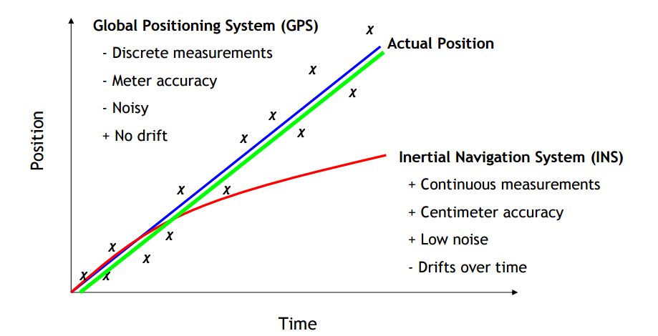
Data Fusion
Combining information from multiple sources will yield better results than if the data is used separately.

Slide 3
Data Fusion for Feature Location
Why do we need Feature Location? To identify the source code that implements the feature.
Feature Location Techniques discussed:
1) IR- Textual information
2) Dynamic Analysis- Execution information
3) Web-mining(novel)-Dependence Information
(Improves effectiveness by 62%)

Slide 4
Textual Information from IR
Information Retrieval (IR)
– Searching for documents or within docs for relevant information
Utilized by many existing approaches: PROMESIR, SITIR etc.
Latent Semantic Indexing- Denoted by IR_{LSI}
Notes:
IR works by comparing a set of artifacts to a query and ranking these artifacts by their relevance to the query.

Slide 5
Applying LSI to Source Code
Corpus creation
– Choose granularity(method-level granularity)
Preprocessing
– Stop word removal, splitting, stemming
Indexing
– Term-by-document matrix
– Singular Value Decomposition
Querying
– User-formulated
Generate results
– Ranked list
Notes:
Preprocessing involves normalizing the text of the documents.
For source code, operators and programming language keywords are removed.
Additionally, identifiers and other compound words are split (e.g., “featureLocation” becomes “feature” and “location”).
Finally, stemming is performed to reduce words to their root forms (e.g., “stemmed” becomes “stem”).

Slide 6
Execution Information from Dynamic Analysis
Involves execution of test case or scenario that invokes the feature to collect execution trace.
Execution information is used as a filter (dyn)
Methods not executed are pruned from the ranked list produced by IR_{LSI}.

Slide 7
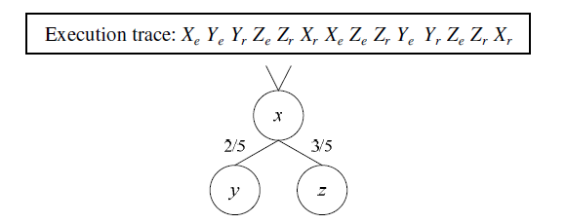
Execution trace translated into a graph
Nodes- Methods , Edges- Method Call
Only executed methods are in the graph
Edges can be:
- weighted - Dyn_{freq}
- weightless - Dyn_{bin}
Notes:
Xe is the entry to method X, and Xr is the return from method X.

Slide 8
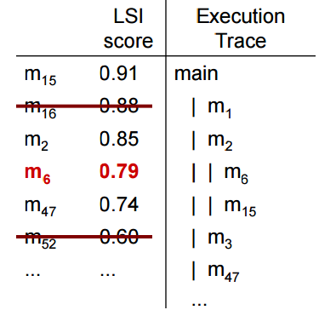
SIngle Trace and Information Retrieval (SITIR)
* Liu, D., Marcus, A., Poshyvanyk, D., and Rajlich, V., "Feature Location via Information Retrieval based Filtering of a Single Scenario Execution Trace", in Proc. of International Conference on Automated Software Engineering, 2007, pp. 234-243.

Slide 9
Dependence Information from Web Mining
Web Mining can be implemented in software by representing as a graph – a call graph.
Nodes represent methods, and edges correspond dependencies among methods.
Techniques- HITS and Page Rank

Slide 10
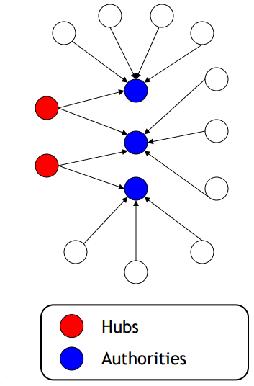
Hyperlinked-Induced Topic Search HITS
– Identifies hub and authority pages
– Hubs point to many good authorities
– Good Authorities are pointed to by many hubs

Slide 11
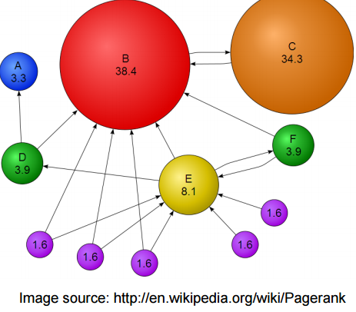
Page Rank
An estimate of the global importance of a method within a system.
Methods that have global significance -ranked highly
Methods relevant to a specific feature – ranked low
Therefore, prune the top-ranked PageRank methods
Edges must be weighted and normalized
Notes:
specific feature – ranked low ( Less global significance)

Slide 12
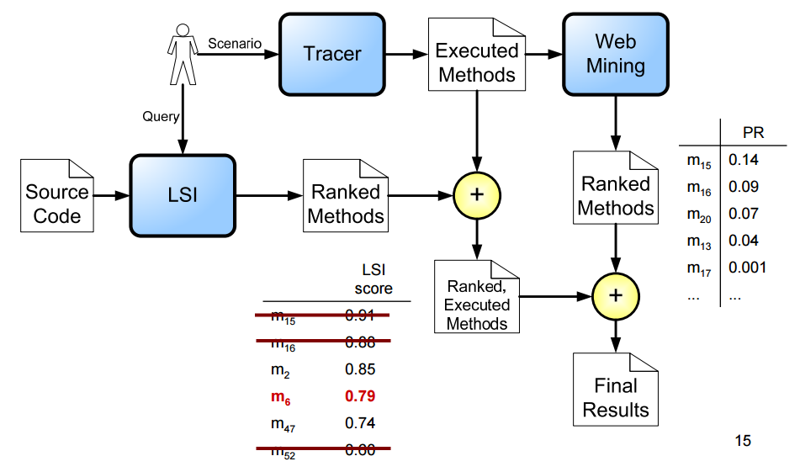
Incorporating Web Mining with Feature Location

Slide 13
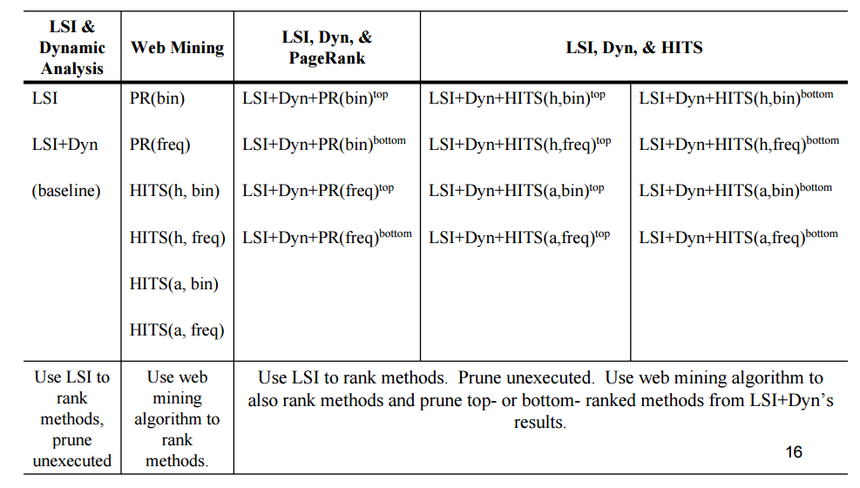
Feature Location Techniques Evaluated

Slide 14

Subject Systems
• Eclipse 3.0
– 10K classes, 120K methods, and 1.6 million LOC – 45 features
– Gold set: methods modified to fix bug
– Queries: short description from bug report
– Traces: steps to reproduce bug

Slide 15
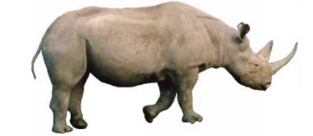
Subject Systems
• Rhino 1.5
– 138 classes, 1,870 methods, and 32,134 LOC
– 241 features
– Gold set: Eaddy et al.’s dataset
– Queries: description in specification
– Traces: test cases
Notes:
The modified methods are considered to be the “gold set” of methods that implement the feature. Since their code had to be altered to correct a problem with the feature, they are likely to be relevant to the feature.

Slide 16
Research Questions
RQ1
– Does combining web mining algorithms with an existing approach to feature location improve its effectiveness?
RQ2
– Which web-mining algorithms, HITS or PageRank, produces better results?

Slide 17
Data Collection & Testing
Effectiveness measure
– The position of the first relevant method from the gold set is referred to as the effectiveness measure
For each Feature location Technique:
• 45 Data points – 45 Eclipse features
• 241 Data points – 45 Rhino features

Slide 18
Data Collection & Testing
Statistical Testing
– Null hypothesis - No significant difference between the effectiveness of X and the baseline(LSI+Dyn).
– Alternative hypothesis - The effectiveness of X is significantly better than the baseline (LSI+Dyn).
– X is an Web Mining technique

Slide 19
Data Collection & Testing
Wilcoxon rank sum test
– to test if the difference between the effectiveness measures of two feature location techniques is statistically significant.

Slide 20
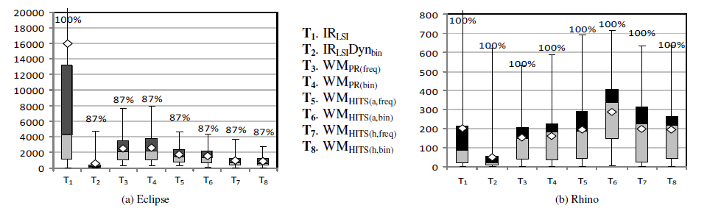
Results: Web Mining Techniques
The values above the boxes represent the % of features for which the technique was able to locate at least 1 relevant method.
Notes:
Many of the techniques in the model filter methods
from consideration, and some of those methods may belong
to the gold set. It is possible for a technique to filter out all
of a feature’s gold set methods and return no relevant results.
Therefore, the percentage of features for which a technique
can locate at least one relevant method is reported.

Slide 21
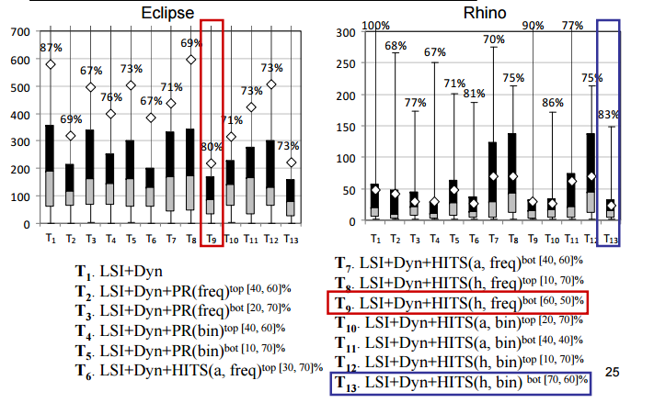
Results: Web Mining Techniques

Slide 22
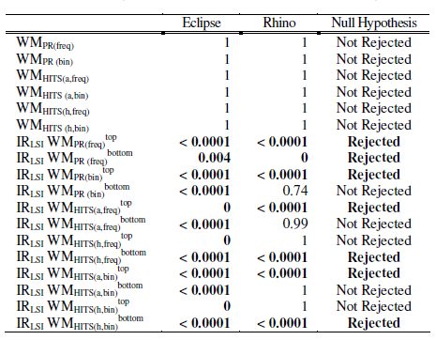
Results: Wilcoxon Test
Null hypotheses for these approaches without significant results for both systems cannot be rejected.

Slide 23
Research Questions-Revisited
RQ1
– Does combining web mining algorithms with an existing approach to feature location improve its effectiveness? Yes
RQ2
– Which web-mining algorithms, HITS or PageRank, produces better results? HITS

Slide 24
Research Questions-Revisited
Best Techniques
LSI+Dyn+HITS(h, freq)_{bottom}
LSI+Dyn+HITS(h, bin)_{bottom}

Slide 25
Questions
What is the difference between the graphs generated using the Web Mining Techniques and the Dynamic Analysis Techniques?
What is effectiveness measure?

